Slide 1
SUB-CONVOLUTIONAL-VASNET BASED SPEECH ENHANCEMENT USING VOICE ACTIVITY DETECTION AND CAUSAL SPATIAL ATTENTION

Slide 2
CONTENTS
Abstract
Literature survey
Existing System
Existing system Drawbacks
Proposed System
Proposed System Advantages
Requirements
Results
Test cases
Conclusion
References

Slide 3
INTRODUCTION
Speech signal in a real world environment is degraded by background noise that reduces its intelligibility and quality for human listeners.
It can further degrade the performance of speech based applications
Speech enhancement aims at improving the intelligibility and quality of speech signal by removing background noise
Single channel speech enhancement in low signal-to-noise ratio(SNR) conditions is considered a very challenging problem
Speech enhancement has been extensively studied in recent years as a supervised learning problem using deep neural networks(DNNs)
Supervised approaches to speech enhancement generally convert a speech signal to a time-frequency representation and extract input features and training targets from it.

Slide 4
ABSTRACT
Speech is the basic important form of communication
People suffering with hearing problem require hearing aids
Speech enhancement is very useful for the hearing impaired people
Speech Enhancement (SE) takes the speech in waveform or time-frequency spectrum
Currently vast research on Deep Nueral Network(DNN) is going on for reducing the error loss of speech.
Quality + Intelligibility= Speech Enhancement

Slide 5
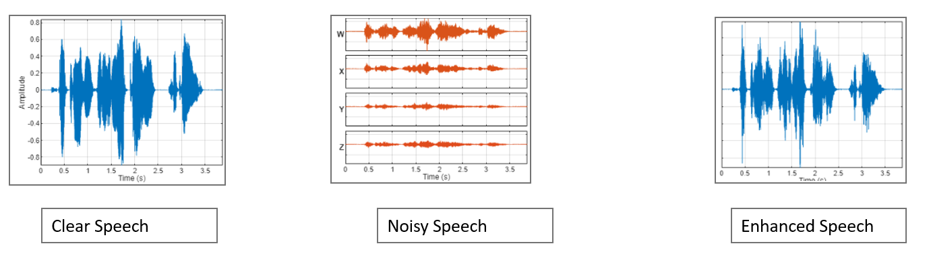
TYPES OF SPEECH

Slide 6
LITERATURE SURVEY
Speech enhancement is the removal of noise from corrupted speech and has applications in cellular and radio communication, voice-controlled devices and as a preprocessing step in automatic speech/speaker recognition.
There are many ways to classify speech enhancement methods. It is usually difficult for a typical algorithm to be able to perform homogenously across all noise types. Therefore, usually a speech enhancement system is based on certain assumptions and constraints that are typically dependent on the application and the environment. In general, the performance of a speech enhancement algorithm is limited by the factors such as limitations on the number of noise sources available, making different uses of a priori information about the signal of interest and/or the corrupting signal, limitations in the time variations (non-stationary) allowed for the corrupting signal, model-based limitations like the restriction of the algorithm to uncorrelated noise.

Slide 7
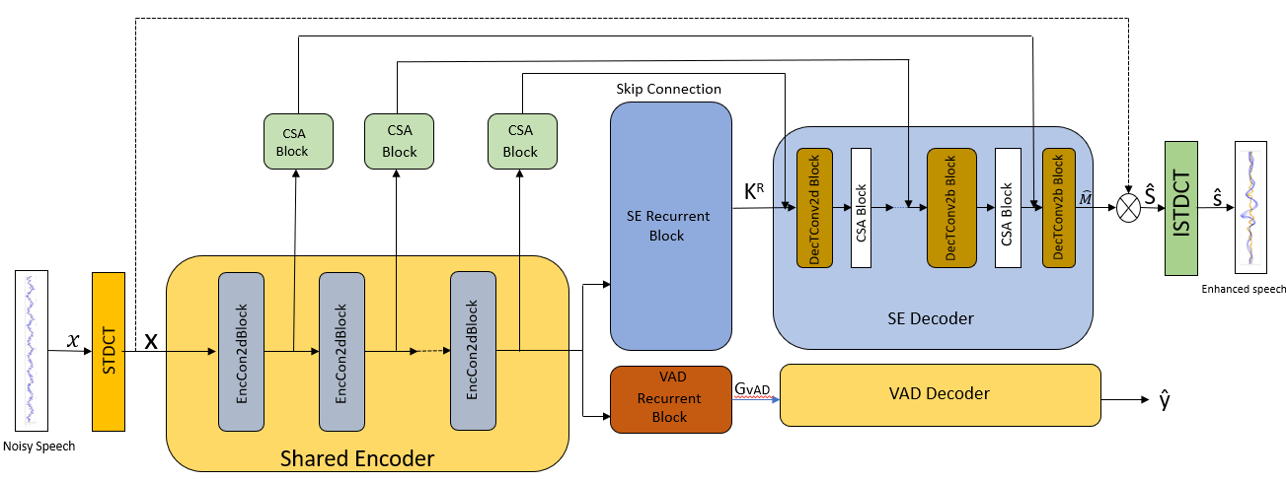
EXISTING SYSTEM
Voice Activity Detection(VAD)
Casual Spatial Attention(CSA)
VAD+CSA=VSANet

Slide 8
Existing System Drawbacks
Complexity: CRNs can be computationally intensive, especially when dealing with large datasets or complex architectures. This complexity can result in longer training times and higher resource requirements, making it less practical for real-time applications or devices with limited computational power.
Training Data Requirements: Like many deep learning approaches, CRNs require large amounts of annotated training data to generalize well across different types of speech signals. Gathering and annotating such datasets can be time-consuming and expensive, especially for tasks requiring fine-grained annotations like speech enhancement.
Overfitting: CRNs, especially when designed with a large number of parameters, are prone to overfitting, wherein the model performs well on the training data but fails to generalize to unseen data. Regularization techniques such as dropout or weight decay can help mitigate overfitting, but finding the right balance between model complexity and generalization performance can be challenging.
Difficulty in Interpretation: Deep learning models, including CRNs, are often considered as black boxes due to their complex architectures and numerous parameters. Understanding how these models make decisions or interpreting their internal representations can be difficult, which may limit their adoption in domains where interpretability is critical.
Data Augmentation Challenges: Data augmentation, a common technique used to artificially increase the size of the training dataset, can be challenging for speech enhancement tasks, particularly when dealing with phase-aware methods like MPSE-PSM. Generating realistic augmented samples while preserving the magnitude and phase characteristics of the original signals can be non-trivial.

Slide 9
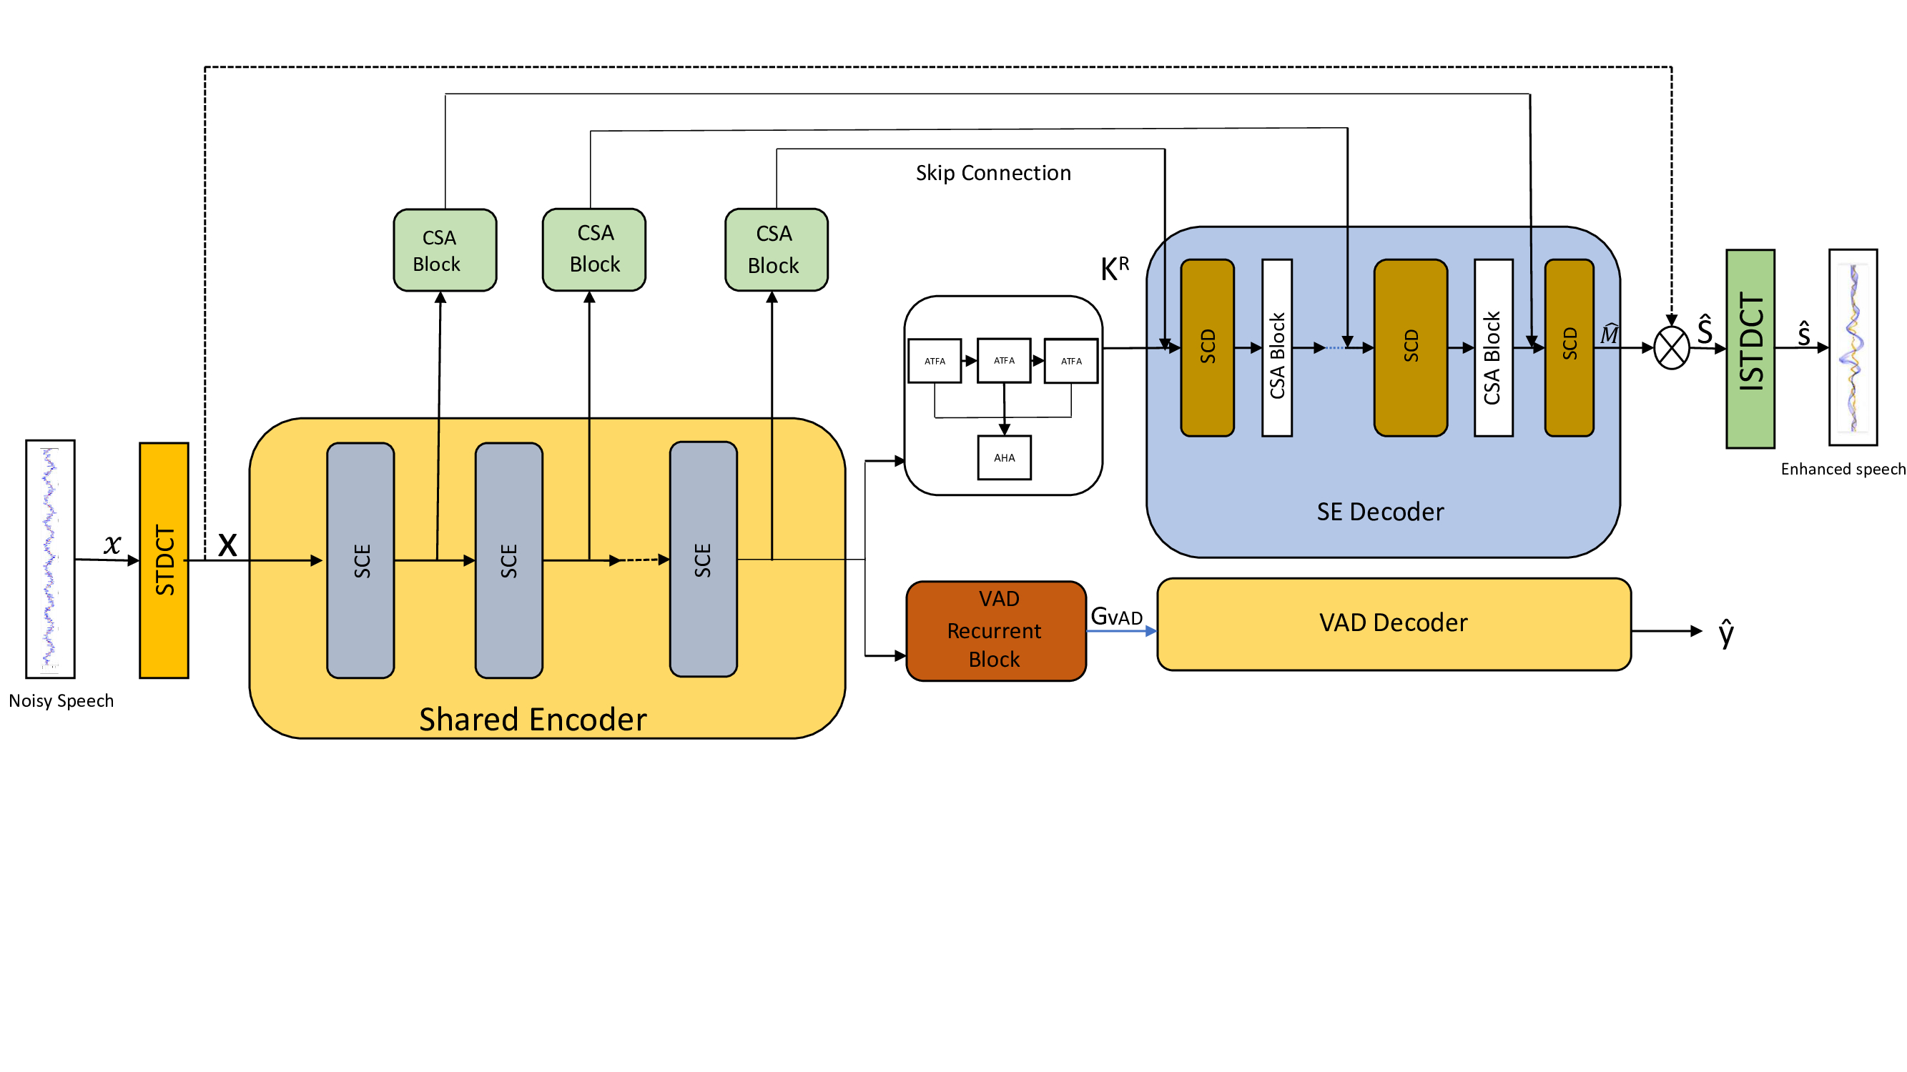
PROPOSED SYSTEM
Sub Convolutional Encoder(SCE)
Sub Convolutional Decoder(SCD)
Adaptive Time-Frequency Attention(ATFA)

Slide 10
Advantages of Proposed System
Sub Convolutional Encoding:
Hierarchical Representation: The Sub Convolutional Encoder hierarchically encodes the input speech signal, capturing both local and global features. This hierarchical representation can help in capturing different levels of abstraction in the input signal, which can be beneficial for various speech enhancement tasks.
Efficient Encoding: By employing sub-convolutional operations, the encoder can efficiently capture complex patterns in the input signal while maintaining computational efficiency.
Sub Convolutional Decoding:
Hierarchical Decoding: Similar to the encoding process, the Sub Convolutional Decoder hierarchically decodes the encoded representation, reconstructing the enhanced speech signal in a hierarchical manner. This hierarchical decoding can help in preserving the structural information of the input signal during the enhancement process.
Quality Enhancement: The decoding process aims to reconstruct the enhanced speech signal from the encoded representation while minimizing information loss. By leveraging sub-convolutional decoding operations, the method can effectively enhance the quality of the reconstructed speech signal.

Slide 11
Proposed System: Speech enhancement using Time-Frequency Attention with Dilated dense convolutions
We have proposed a Dilated Time Frequency Attention Autoencoder(DTAAEC) model.
This model has output layer, an encoder, an input layer, a decoder, dilated Convolution Blocks , dense block and TFA block.
Two Gated Recurrent Unit (GRU) layers are used in between encoder and decoder. GRU offers promising features for balancing fast computation with data capture capabilities in terms of time-series mapping between datasets.
The concept underlying densely connected networks is feature reuse, where an output from one layer is utilized again in succeeding levels
TFA mechanism is used to extract useful frequency, channel, and time data from the inputs of spectrogram.
The energy This time-frequency attention layer extracts both time and frequency features separately.

Slide 12
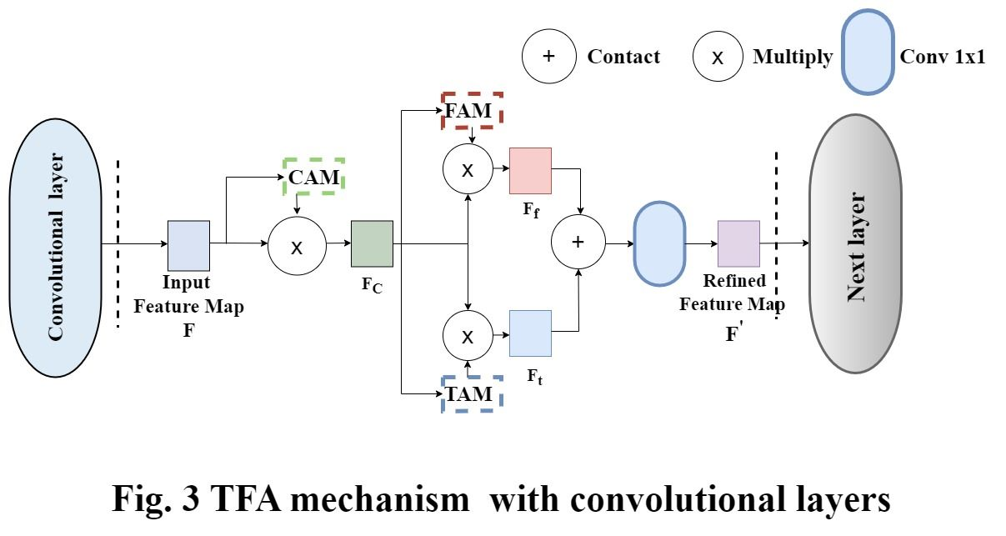

Slide 13
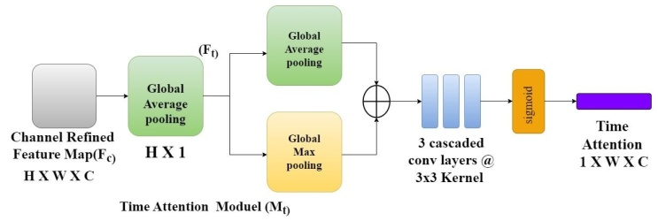
Time Attention Module

Slide 14
Software Requirements
Software: Google colab, MATLAB, python
Version: 3.8
Operating System: windows

Slide 15
Hardware Requirements
Processor: Intel core I5
RAM:8GB
Hard Disk:500GB or More
A working microphone
Working Speakers

Slide 16
RESULTS
Model | Noisy | RNNoise [30] | CRN [5] | DCCRN [6] | PercepNet [31] | DeepMMSE [32] | DCCRN+[33] | DEMUCS [4] | Full SubNet+ [34] | LFSFNET [35] | GaGNet [36] | VSANet (ours) | Proposed
Year | - | 2018 | 2018 | 2020 | 2020 | 2020 | 2021 | 2021 | 2022 | 2022 | 2022 | 2023 | 2024
Input | - | Magnitude | Magnitude | Complex | Magnitude | Magnitude | Complex | Time | Complex & Magnitude | Magnitude | Complex | STDCT Spectrum- | STDCT Spectrum
Cau. | - | ✓ | ✓ | ✓ | ✓ | ✓ | ✓ | ✓ | ✓ | ✓ | ✓ | ✓ | ✓
WB-PESQ | 1.97 | 2.29 | 2.56 | 2.68 | 2.73 | 2.77 | 2.84 | 2.93 | 2.88 | 2.91 | 2.94 | 2.98 | 2.99
CSIG | 3.35 | - | 3.51 | 3.88 | - | 4.14 | - | 4.22 | 3.86 | - | 4.26 | 4.21 | 4.22
CBAK | 2.44 | - | 2.98 | 3.18 | - | 3.32 | - | 3.25 | 3.42 | - | 3.45 | 3.51 | 3.51
COVL | 2.63 | - | 3.02 | 3.27 | - | 3.46 | - | 3.52 | 3.57 | - | 3.59 | 3.60 | 3.61

Slide 17
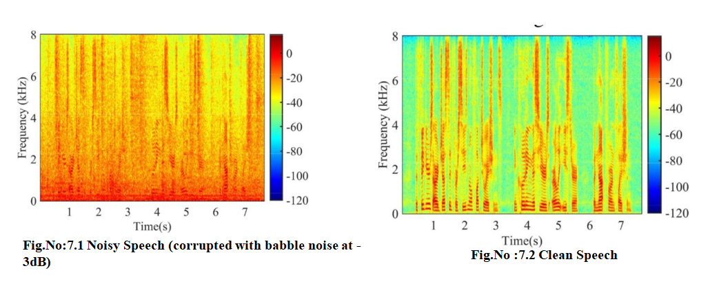
RESULTS

Slide 18
TEST CASES

Slide 19
CONCLUSION
The work introduces a novel approach to speech enhancement (SE) using a Convolutional Spatial Attention (CSA) block and a Voice Activity Detection (VAD)-assisted multi-task learning framework. A two-branch network is designed to handle SE and VAD tasks concurrently, with joint optimization improving SE performance. The CSA block enhances feature extraction, ensuring real-time SE. The TANSCUNet model incorporates innovative techniques like sub-convolutional encoders, demonstrating the importance of local and global contextual information in speech. The VSANet, integrating these advancements, achieves better real-time SE despite its modest size. Future research aims to explore more potent multitask learning schemes and extend techniques to other areas like speech dereverberation and separation.

Slide 20
Thank You

